Slide 1
project 2
Deploy a Static Website on AWS
Presented by Krati Pandey

Slide 2
About the project
In this project we will learn how to create static website and deploy it using AWS services .A static website is a site that consist of HTML , CSS and JavaScript files and it does not require server -side processing or a database.

Slide 3
Lab steps
Task 1 : Sign in to AWS management console
1. Click on the AWS console button and you will get redirected to the AWS console in a new browse tab.
2. On the AWS sign in page
(a) Leave the account id as default. Never edit/remove 12 digit account ID present in the AWS console. Otherwise , you can not proceed the lab.
(b) Now copy your user name password in the lab console to the IAM user and password in the AWS console and click to the sign in button.
3. Once signed to the AWS management console , make the default AWS region Asia Pacific (Mumbai) ap-south-1.
Task 2: Create 1 Amazone S3 Bucket
Navigate to service menu in the top then click on S3 in the storage section.
Click on create bucket button.
Enter your bucket name mybucket2112.(every bucket is unique globally)
Click the option ACL is enabled.

Slide 4
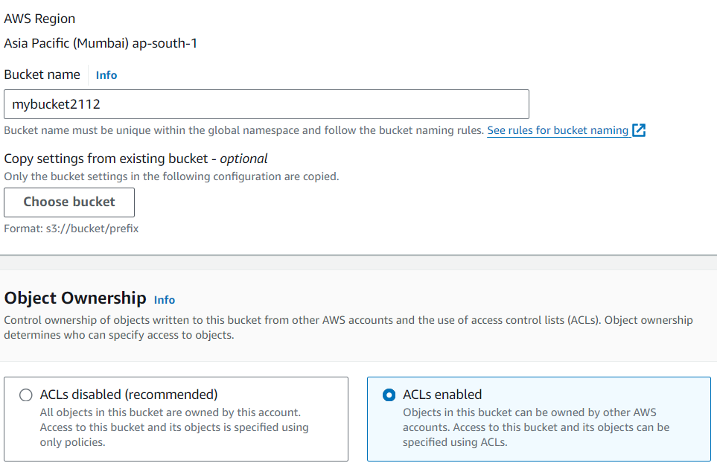
5. Untick block all public access option
6. Click on the option create bucket.

Slide 5
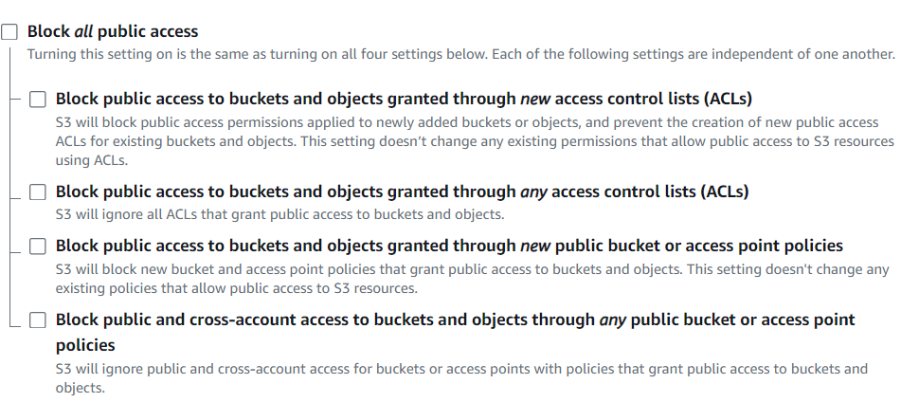
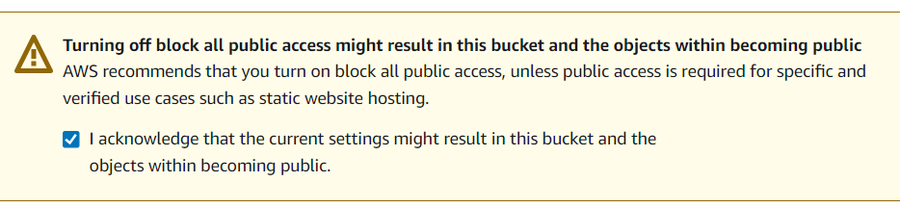

Slide 6
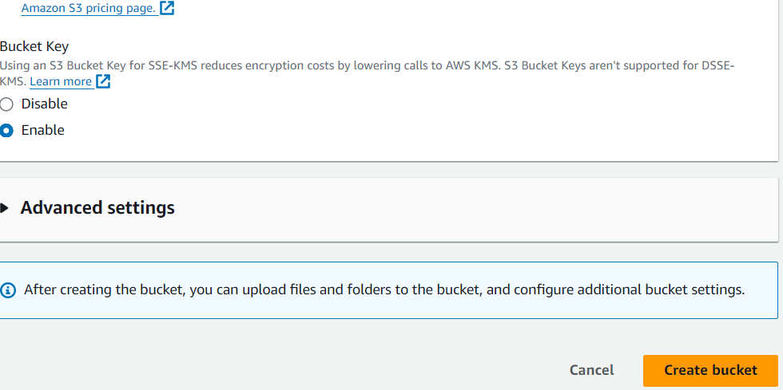
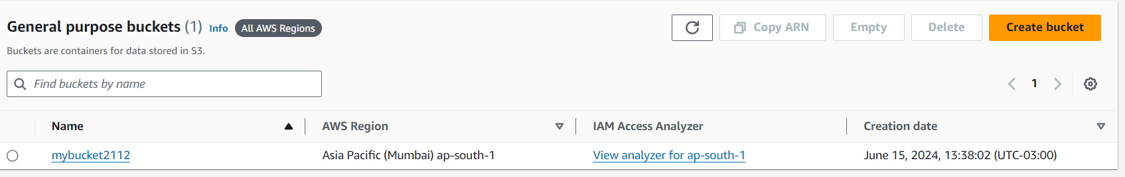
7.Now your bucket has been created.
8.Now upload the HTML file in this bucket by clicking the upload & add files.
7

Slide 7
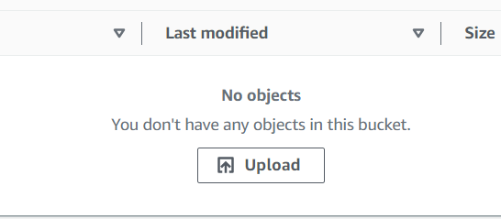
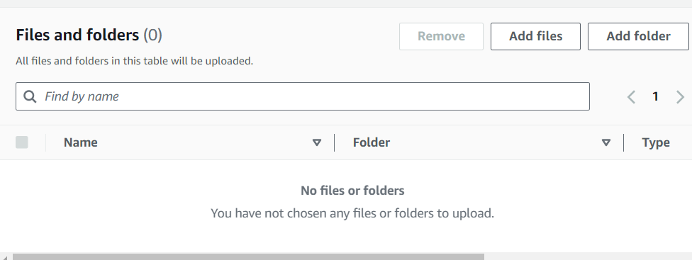
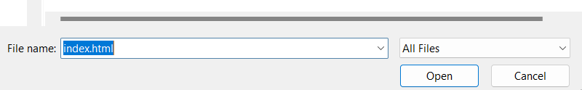

Slide 8
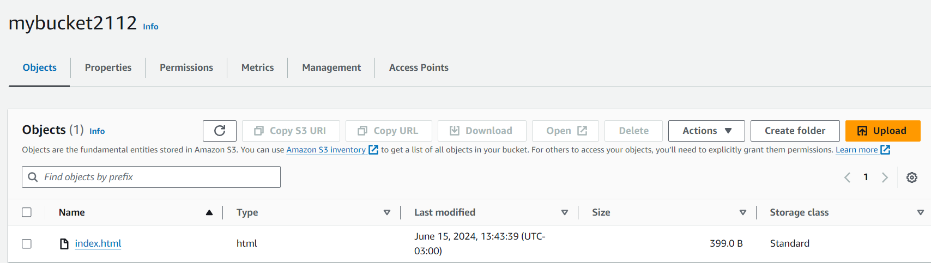
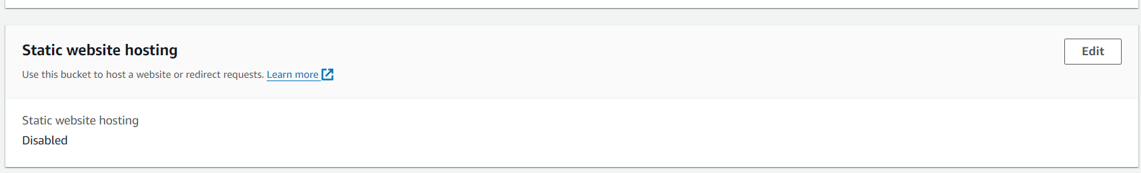
9.Click on the option upload .your file has been uploaded in this bucket.
10. Now go to the option properties under properties we have to enable the static website hosting so we click on the edit option.

Slide 9
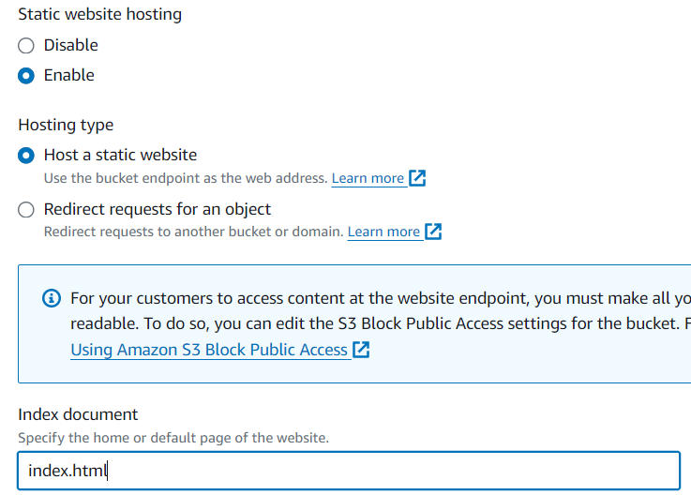
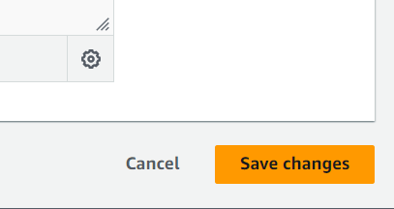
11.Enable static website hosting & under index document write your file name & click on save changes.

Slide 10
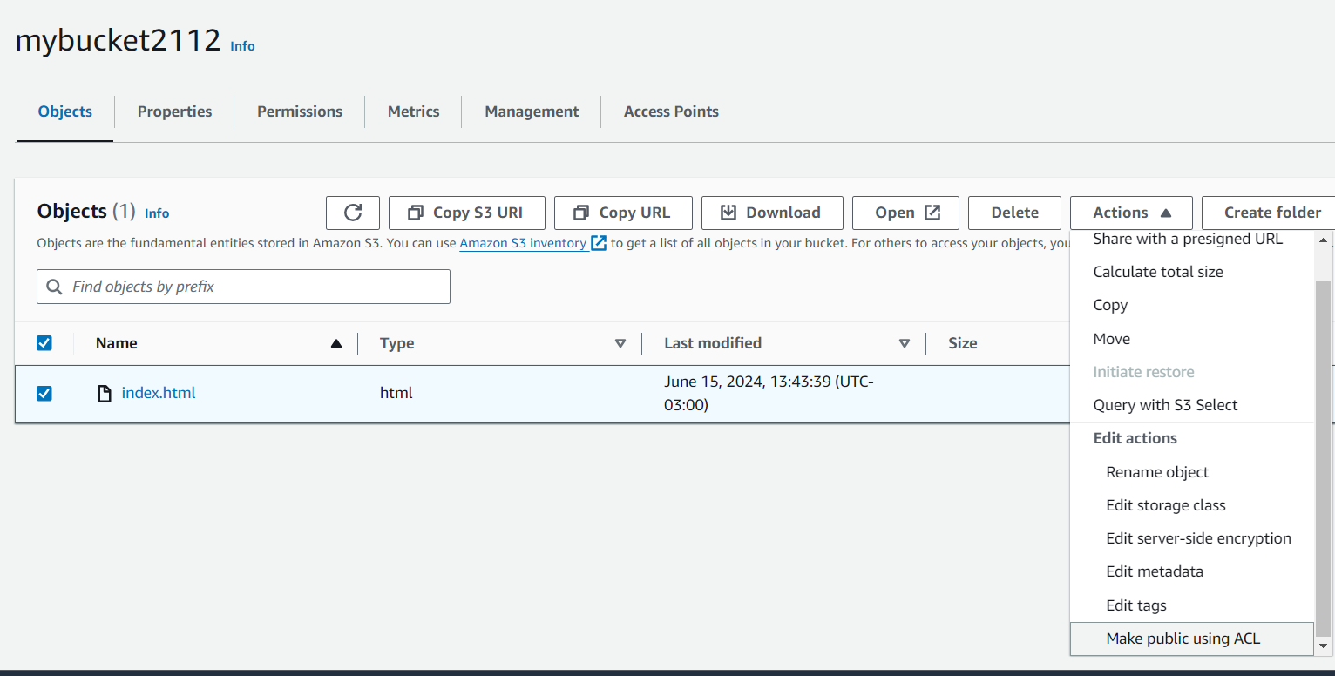
12. Now go to the object option select your file & go to the action under action select the option make public using ACL.

Slide 11
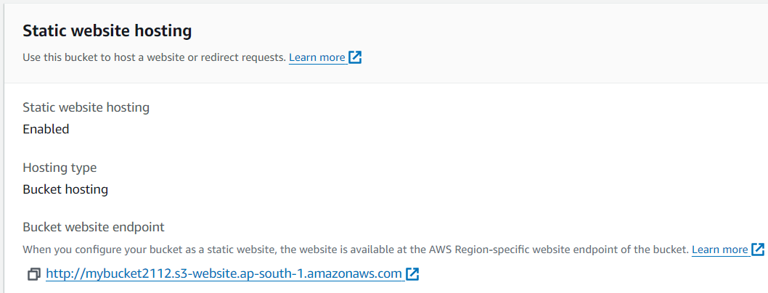
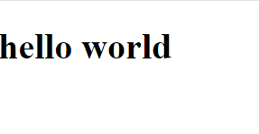
13.Then again go to the properties under properties go to the static website hosting , there is a URL click on the URL . your html file will be opened.

Slide 12
Thank you

